Slide 1
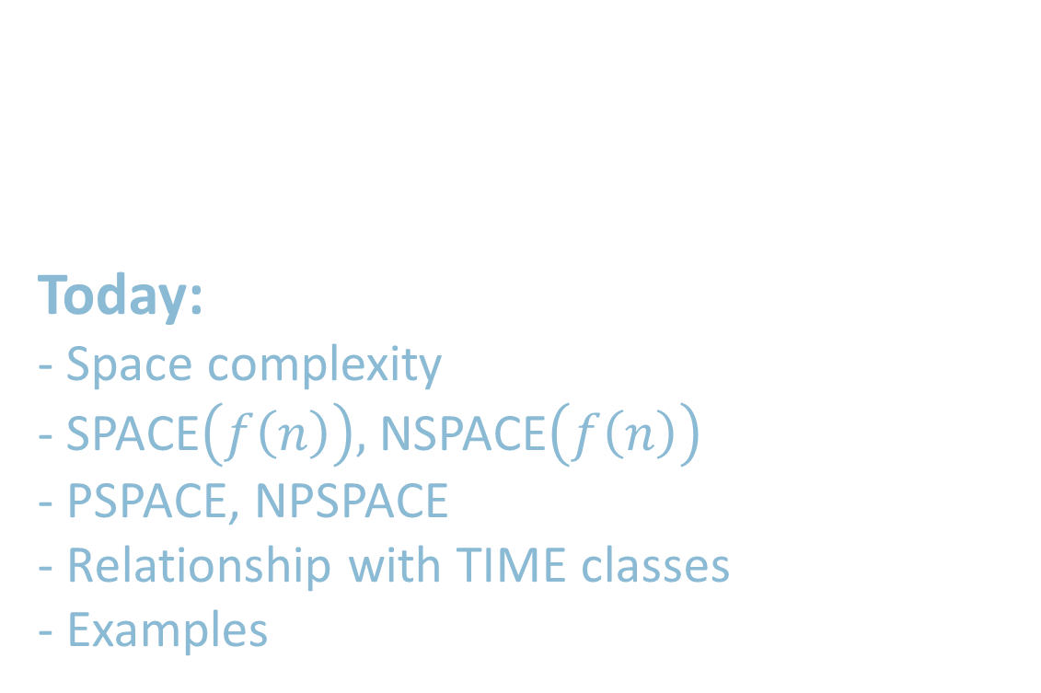
18.404/6.840 Lecture 17
Last time:
- Cook-Levin Theorem: $SAT$ is NP-complete
- $3SAT$ is NP-complete
Today:
- Space complexity
- SPACE$\left(f\left(n\right)\right),$NSPACE$\left(f\left(n\right)\right)$
- PSPACE, NPSPACE
- Relationship with TIME classes
- Examples

Slide 2

SPACE Complexity
Defn: Let $f: ℕ→ℕ$ where $f\left(n\right)≥n$. Say TM $M$ runs in space $f(n)$ if $M$ always halts and uses at most $f(n)$ tape cells on all inputs of length $n$.
An NTM $M$ runs in space $f(n)$ if all branches halt and each branch uses at most $f(n)$ tape cells on all inputs of length $n$.
Defn: SPACE$\left(f\left(n\right)\right)=\{B|$some deterministic 1-tape TM $M$ decides $B$
and $M$ runs in space $O\left(f\left(n\right)\right)\}$
NSPACE$\left(f\left(n\right)\right)=\{B|$some nondeterministic 1-tape TM $M$ decides $B$
and $M$ runs in space $O\left(f\left(n\right)\right)\}$
PSPACE $= \bigcup_{k}{\text{SPAC}\text{E}(n^{k})}$ “polynomial space”
NPSPACE $= \bigcup_{k}{\text{NSPAC}\text{E}(n^{k})}$ “nondeterministic polynomial space”
Check-in 17.1
We define space complexity for multi-tape TMs by taking the sum of the cells used on all tapes.
Do we get the same class PSPACE for multi-tape TMs?
No.
Yes, converting a multi-tape TM to single-tape only squares the amount of space used.
Yes, converting a multi-tape TM to single-tape only increases the amount of space used by a constant factor.
Check-in 17.1

Slide 3

Relationships between
Time and SPACE Complexity
Theorem: For $t\left(n\right)≥n$
1) TIME$\left(t\left(n\right)\right)⊆$ SPACE$\left(t\left(n\right)\right)$
2) SPACE$\left(t\left(n\right)\right)⊆$ TIME$\left(2^{O\left(t\left(n\right)\right)}\right)$
$=\bigcup_{c}{\text{TIME}\left(c^{t\left(n\right)}\right)}$
Proof:
1) A TM that runs in $t(n)$ steps cannot use more than $t(n)$ tape cells.
2) A TM that uses $t(n)$ tape cells cannot use more than $c^{t\left(n\right)}$ time
without repeating a configuration and looping (for some $c$).
Corollary: P $⊆$PSPACE
Theorem: NP $⊆$PSPACE [next slide]

Slide 4


NP $⊆$PSPACE
Theorem: NP $⊆$PSPACE
Proof:
$SAT∈$ PSPACE
If $A≤_{P}B$ and $B∈$ PSPACE then $A∈$ PSPACE
Defn: coNP $=\left\{\overline{A}\right| A∈$ NP}
$\overline{HAMPATH}∈$ coNP
$TAUTOLOGY=\left\{〈φ〉\right|$all assignments satisfy $φ\}∈\text{coNP}$
coNP $⊆$ PSPACE (because PSPACE = coPSPACE)
P = PSPACE ? Not known.
PSPACE
coNP
NP
Or possibly:
P
P = NP = coNP = PSPACE

Slide 5

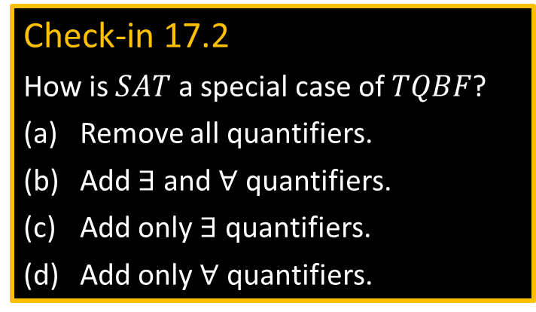
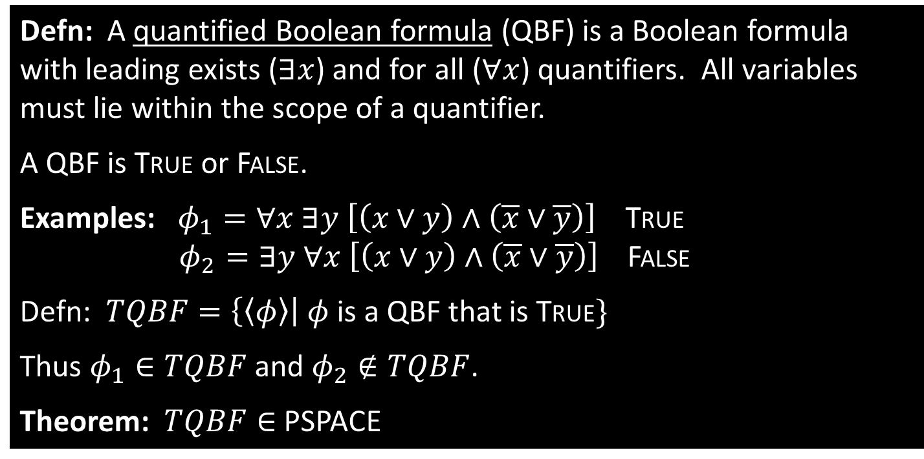
Example: $TQBF$
Defn: A quantified Boolean formula (QBF) is a Boolean formula with leading exists ($∃x$) and for all ($∀x$) quantifiers. All variables must lie within the scope of a quantifier.
A QBF is True or False.
Examples: $φ_{1}=∀x ∃y \left[\left(x∨y\right)∧\left(\overline{x}∨\overline{y}\right)\right]$ True
$φ_{2}=∃y ∀x \left[\left(x∨y\right)∧\left(\overline{x}∨\overline{y}\right)\right]$ False
Defn: $TQBF=\left\{〈φ〉\right| φ$ is a QBF that is True$\}$
Thus $φ_{1}∈TQBF$ and $φ_{2}∉TQBF$.
Theorem: $TQBF∈$ PSPACE
Check-in 17.2
How is $SAT$ a special case of $TQBF$?
Remove all quantifiers.
Add $∃$ and $∀$ quantifiers.
Add only $∃$ quantifiers.
Add only $∀$ quantifiers.
Check-in 17.2

Slide 6


$TQBF∈$ PSPACE
Theorem: $TQBF∈$ PSPACE
Proof: “On input $〈φ〉$
1. If $φ$ has no quantifiers, then $φ$ has no variables
so either $φ=$True or $φ=$False. Output accordingly.
2. If $φ=∃x ψ$ then evaluate $ψ$ with $x=$ True and $x=$ False recursively.
Accept if either accepts. Reject if not.
3. If $φ=∀x ψ$ then evaluate $ψ$ with $x=$ True and $x=$ False recursively.
Accept if both accept. Reject if not.”
Space analysis:
Each recursive level uses constant space (to record the $x$ value).
The recursion depth is the number of quantifiers, at most $n=|〈φ〉|$.
So $TQBF∈$ SPACE$(n)$

Slide 7


Slide 8

Example: Ladder Problem
A ladder is a sequence of strings of a common length where consecutive strings differ in a single symbol.
A word ladder for English is a ladder of English words.
Let $A$ be a language. A ladder in $A$ is a ladder of strings in $A$.
Defn: $LADDER\text{DFA}=\left\{〈B,u,v〉\right|$ $B$ is a DFA and $L(B)$ contains a ladder $y_{1}, y_{2}, …, y_{k}$ where $y_{1}=u$ and $y_{k}=v$}.
Theorem: $LADDER\text{DFA}$ $∈$ NPSPACE
WORK
PORK
PORT
SORT
SOOT
SLOT
PLOT
PLOY
PLAY
PLAY

Slide 9









$LADDER\text{DFA}$ $∈$ NPSPACE
Theorem: $LADDER\text{DFA}$ $∈$ NPSPACE
Proof idea: Nondeterministically guess the sequence from $u$ to $v$.
Careful- (a) cannot store sequence, (b) must terminate.
Proof: “On input $〈B,u,v〉$
1. Let $y=u$ and let $m=|u|$.
2. Repeat at most $t$ times where $t={\left|Σ\right|}^{m}$.
3. Nondeterministically change one symbol in $y$.
4. Reject if $y∉L(B)$.
5. Accept if $y=v$.
6. Reject [exceeded $t$ steps].
Space used is for storing $y$ and $t$.
$LADDER\text{DFA}$ $∈$ NSPACE$(n)$.
Theorem: $LADDER\text{DFA}$ $∈$ PSPACE (!)
WORK
PORK
PORT
SORT
SOOT
SLOT
PLOT
PLOY
PLAY
$$≤t$$
˽ ˽
$$u$$
$$v$$
$$y$$
$$t$$
$$n$$
$$O(n)$$

Slide 10
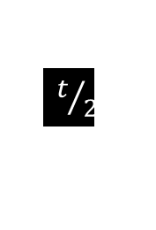

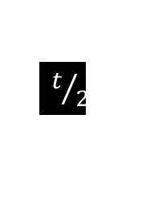



$LADDER\text{DFA}$ $∈$ PSPACE
Theorem: $LADDER\text{DFA}$ $∈$ SPACE$(n^{2})$
Proof: Write $u$ $\underset{→}{ b } v$ if there’s a ladder from $u$ to $v$ of length $≤b$.
Here’s a recursive procedure to solve the bounded DFA ladder problem:
$BOUNDED$-$LADDER\text{DFA}$ $= \left\{〈B,u,v,b〉\right| B$ a DFA and $u \underset{→}{ b } v$ by a ladder in $L(B)\}$
$B$-$L=$“On input $〈B,u,v,b〉$ Let $m=\left|u\right|=|v|$.
1. For $b=1$, accept if $u,v∈L(B)$ and differ in $≤1$ place, else reject.
2. For $b>1$, repeat for each $w$ of length $|u|$
3. Recursively test $u\underset{→}{b/2}w$ and $w\underset{→}{b/2}v$ [division rounds up]
4. Accept both accept.
5. Reject [if all fail].”
Test $〈B,u,v〉∈LADDER\text{DFA}$ with $B$-$L$ procedure on input $〈B,u,v,t〉$ for $t={\left|Σ\right|}^{m}$
WORK
PLAY
$t/2$
Check-in 17.3
Find an English word ladder connecting MUST and VOTE.
Already did it.
I will.
recurse
AAAB
AAAC
AAAA
AAAD
AAAZ
AABA
AABB
ABLE
$$t$$
Space analysis:
Each recursive level uses space $O\left(n\right)$ (to record $w$).
Recursion depth is $\log{t}=O\left(m\right)=O(n)$.
Total space used is $O(n^{2})$.
recurse
$t/2$
Check-in 17.3
Notes:
MUST, MOST, LOST, LOSE, ROSE, ROTE, VOTE

Slide 11

Quick review of today
Space complexity
SPACE$\left(f\left(n\right)\right),$NSPACE$\left(f\left(n\right)\right)$
PSPACE, NPSPACE
Relationship with TIME classes
$TQBF∈$PSPACE
$LADDER\text{DFA}$ $∈$ NSPACE$(n)$
$LADDER\text{DFA}$ $∈$ SPACE$(n^{2})$

